Slide 1
Final report
Team 1
Group 6

Slide 2

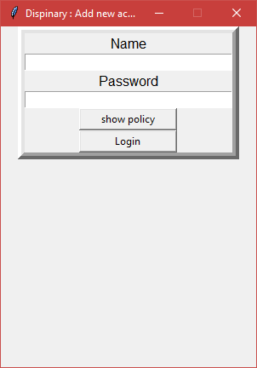
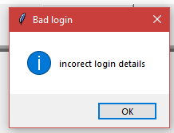
Program progress
Login screen
Will require a user’s first name and password
Will open the main disciplinary action screen if successfully logged in
Shows error message if incorrect name or password enter
Has a policy button to show the company’s policy

Slide 3
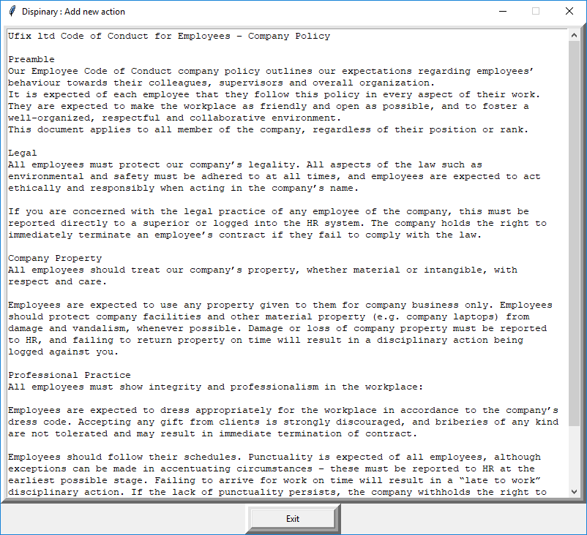
Program progress
Policy screen
Shows company Policy

Slide 4
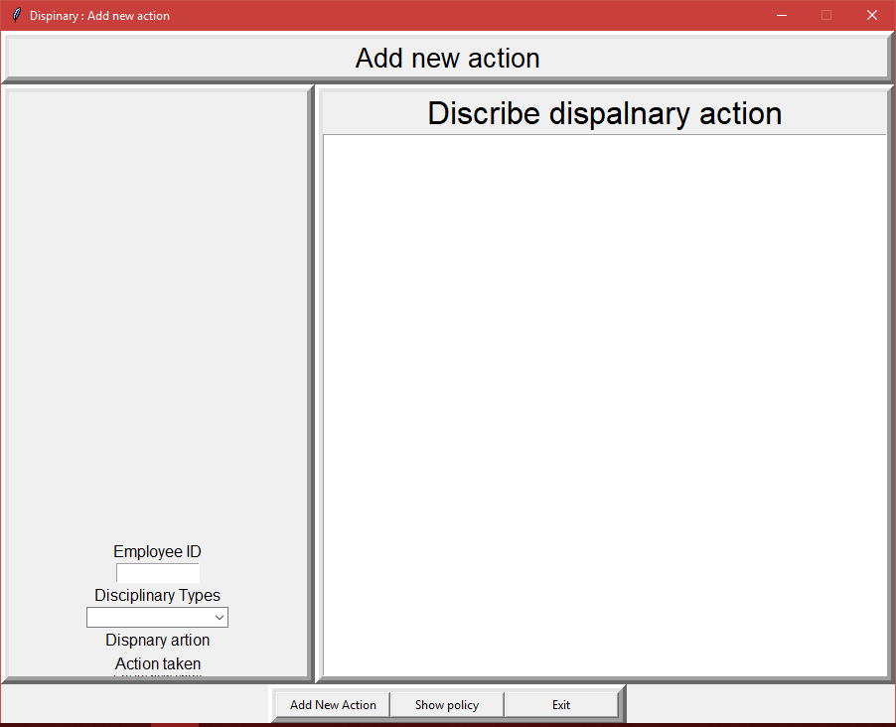
Program progress
Disciplinary action

Slide 5
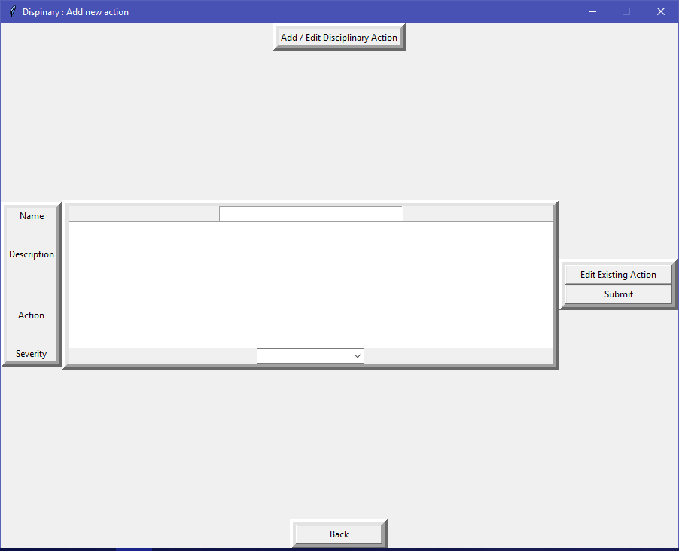
Program progress
Disciplinary action

Slide 6
Testing
Some test cases have been created
Some tests have been completed
There is still much testing left to do
Side note:
The unittest module has not been used much, due to the way the code was written. Looking back, it would have been better to use an object oriented design to make better use of unit testing.
We are considering converting to an object oriented solution (if we have time)

Slide 7
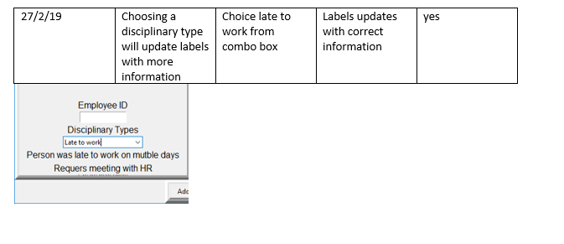
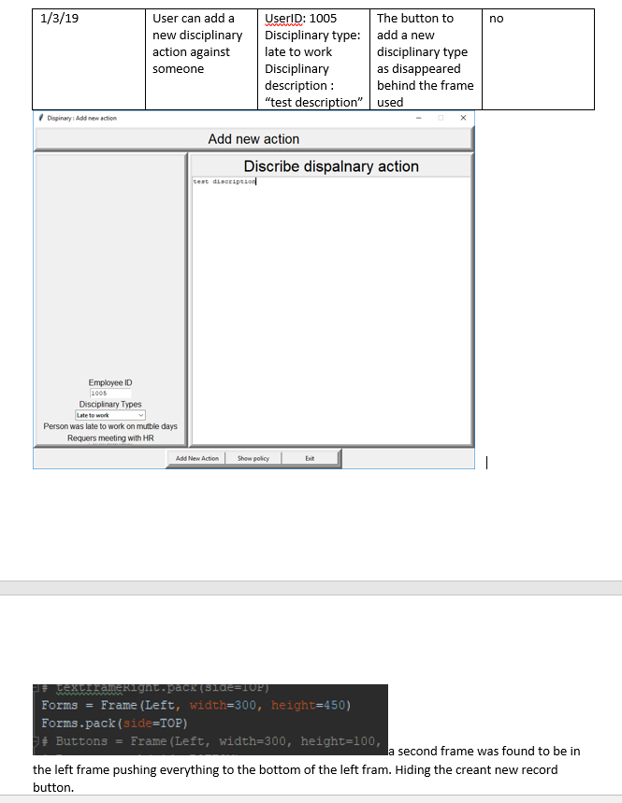
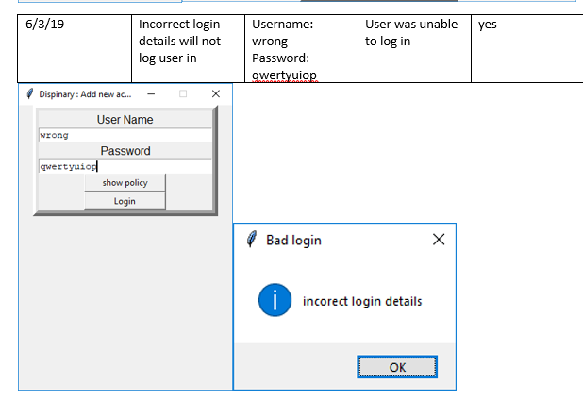
Testing
Example test cases

Slide 8
Vulnerabilities Research
We have begun our research on vulnerabilities
For example: SQL Injections
Using regular string formatting is vulnerable to SQL injection
Users can exploit the strings to insert their own instructions
To avoid this, can use parameters:
If the user enters “105 OR 1=1”, the following SQL instruction will be executed:
Which is true for all users, and so the whole user database is returned

Slide 9
Vulnerabilities Research
Other potential vulnerabilities may include:
Insecure password storage
Poor backup management
Interaction between different parts of the database (in particular parts that were written by different teams)

Slide 10
Any Questions?
Contact Details:
Matthew: 17025958@students.southwales.ac.uk
Joshua: 16028414@students.southwales.ac.uk
Aleksander: 17111854@students.southwales.ac.uk

